Slide 1
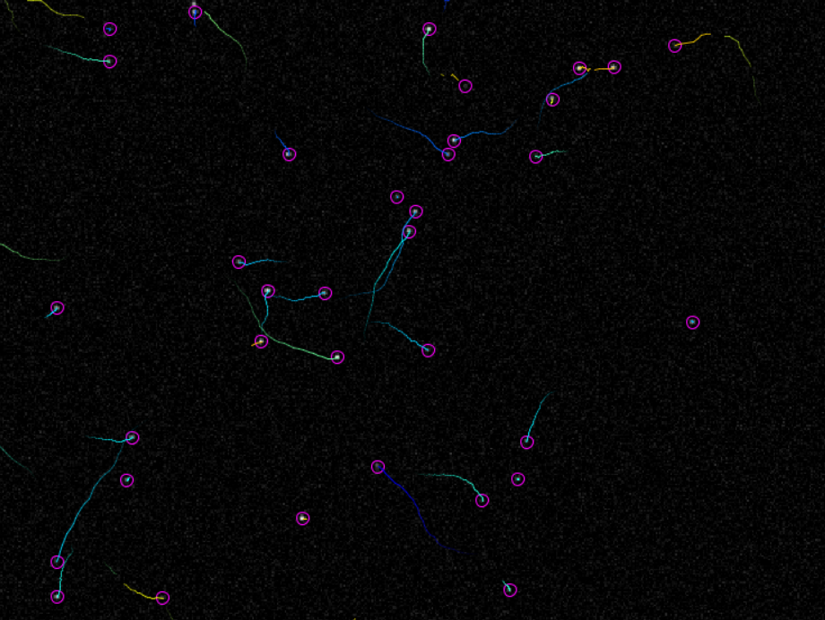
Introduction to Tracking Part 1

Slide 2
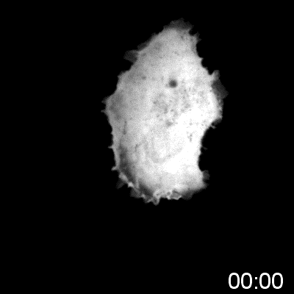
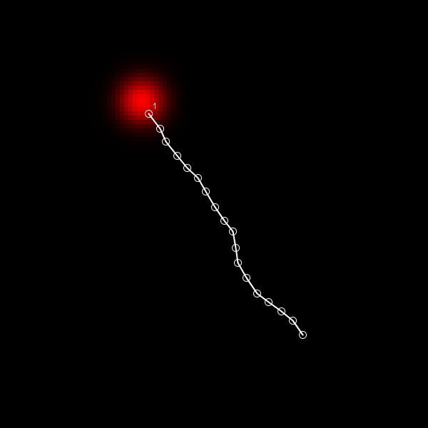
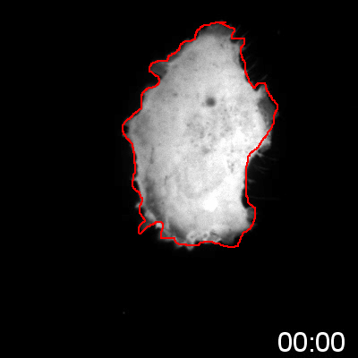
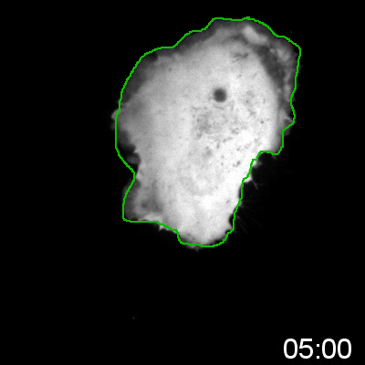
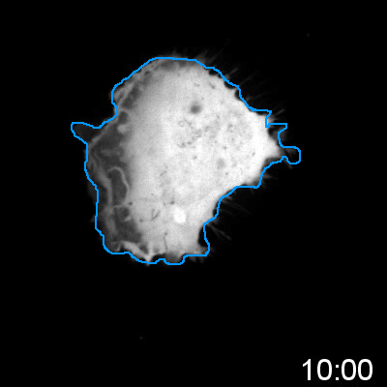
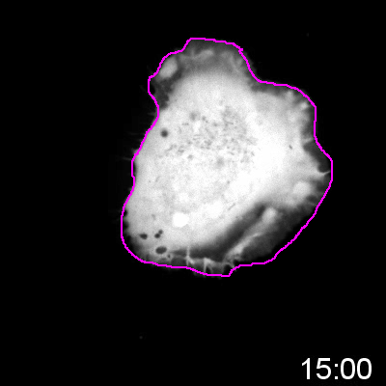
Common experimental output
Typically quantified manually:
Time-consuming
Inaccurate
Biased

Slide 3
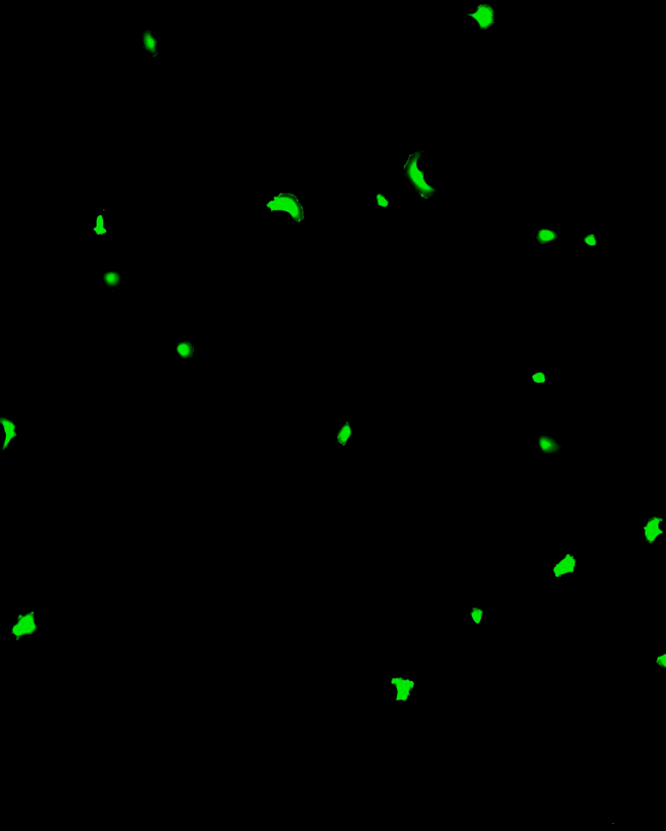
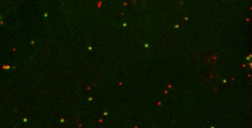
Problems generally involve cells or sub-cellular particles

Slide 4
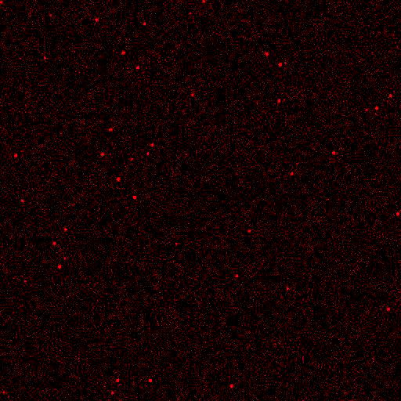
We’ll mostly be using synthetic Images
Diffraction-limited dots good model for detection algorithms

Slide 5
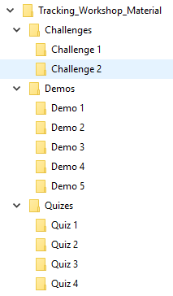
There is a prize (and pride) at stake
2 Teams
4 Quizzes - 13 Points in total
2 Challenges - 12 Points in total
Team with highest score in June 2020 wins a prize
Team with lowest score will be named & shamed

Slide 6



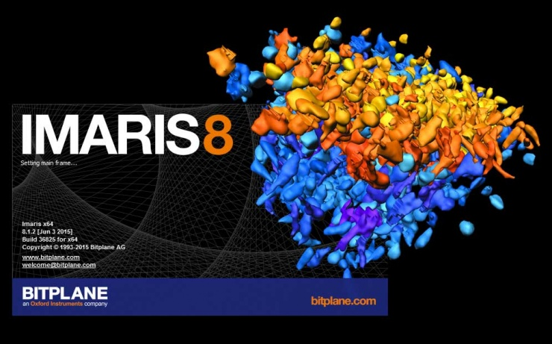
In terms of software…
Most employ similar algorithms
FIJI plugins:
TrackMate
QuimP
ADAPT
CellProfiler
Numerous Commercial Packages:
Imaris
Arivis
Huygens
MetaMorph
Phasefocus Livecyte

Slide 7
Two common methodologies
Detect then track:
Detect objects in each frame
Associate detections
Detect, propagate, detect:
Detect objects in first frame
Evolve detection

Slide 8
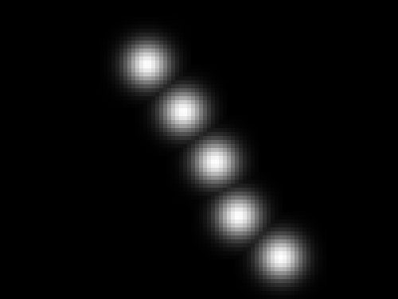
Demo 1 – manual tracking
Manual tracking with MTrackJ:
Enable ImageScience update site
Track object and measure velocity

Slide 9
QUIZ 1 – limitations of manual tracking
Open the datasets in the Quiz 1 folder.
What is the mean speed of the particle in each data set?
No matter how careful you are, the result you get will be wrong! Why?

Slide 10
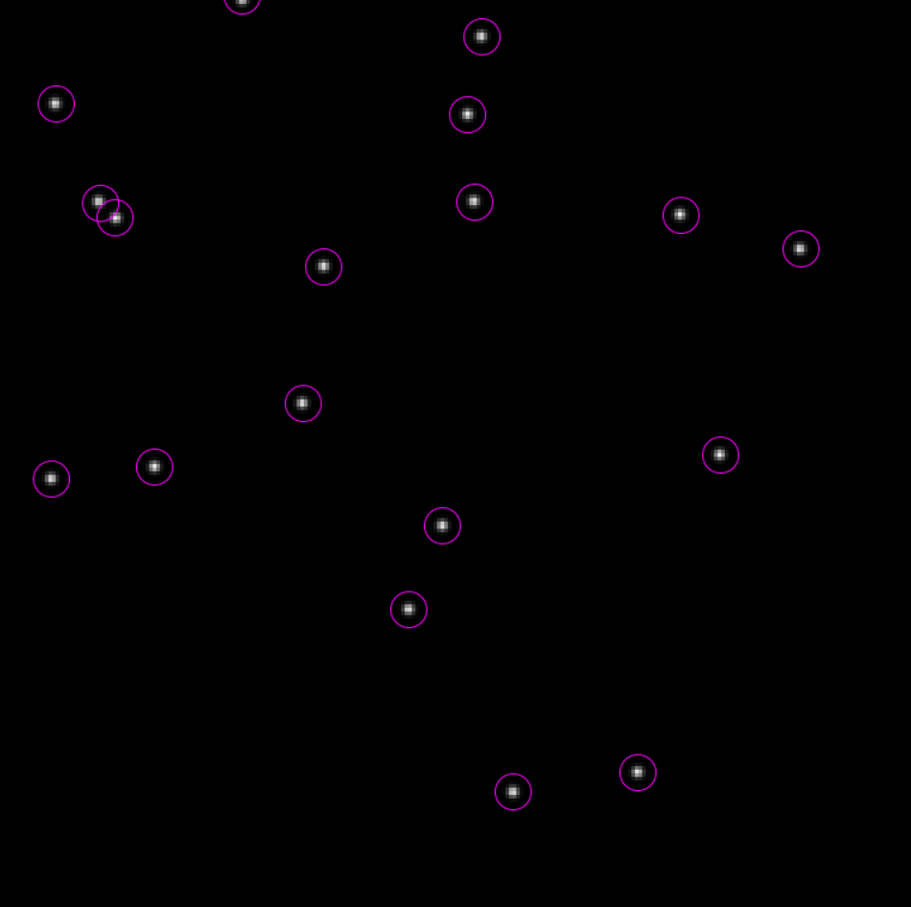
Object Detection
Detecting objects to be tracked

Slide 11
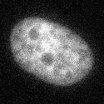

What is image segmentation?
Background labelled white
Background
Foreground labelled black
Foreground
Process of dividing image into regions
Assigning labels to each pixel
“Binary” or “Mask” Image

Slide 12
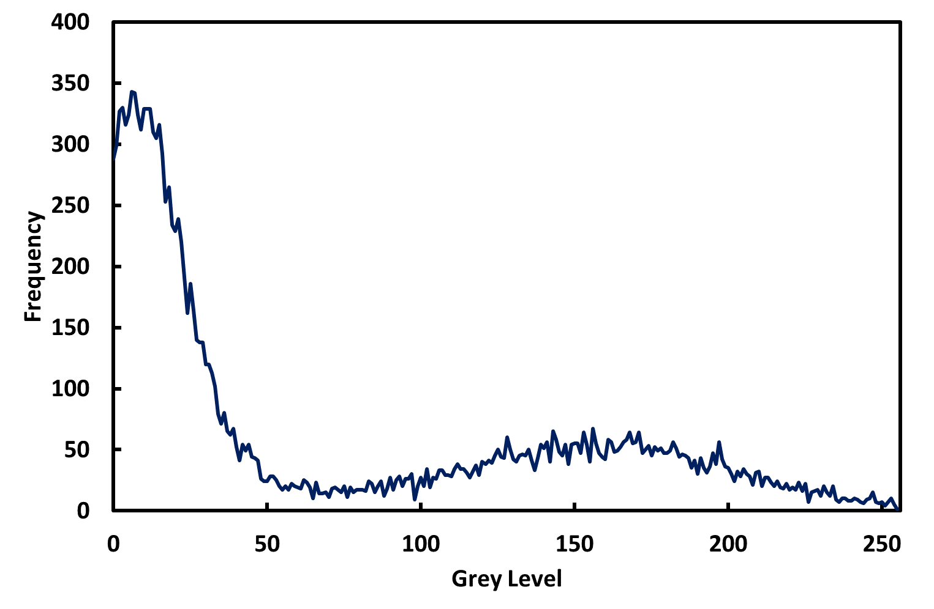
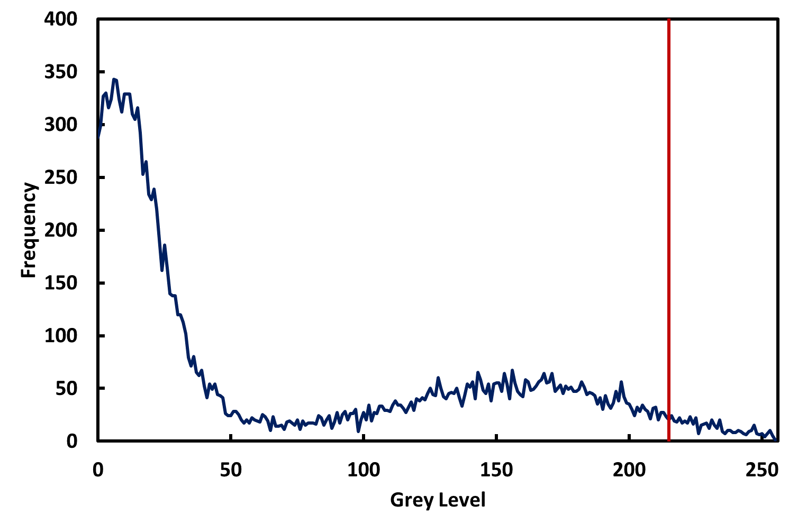
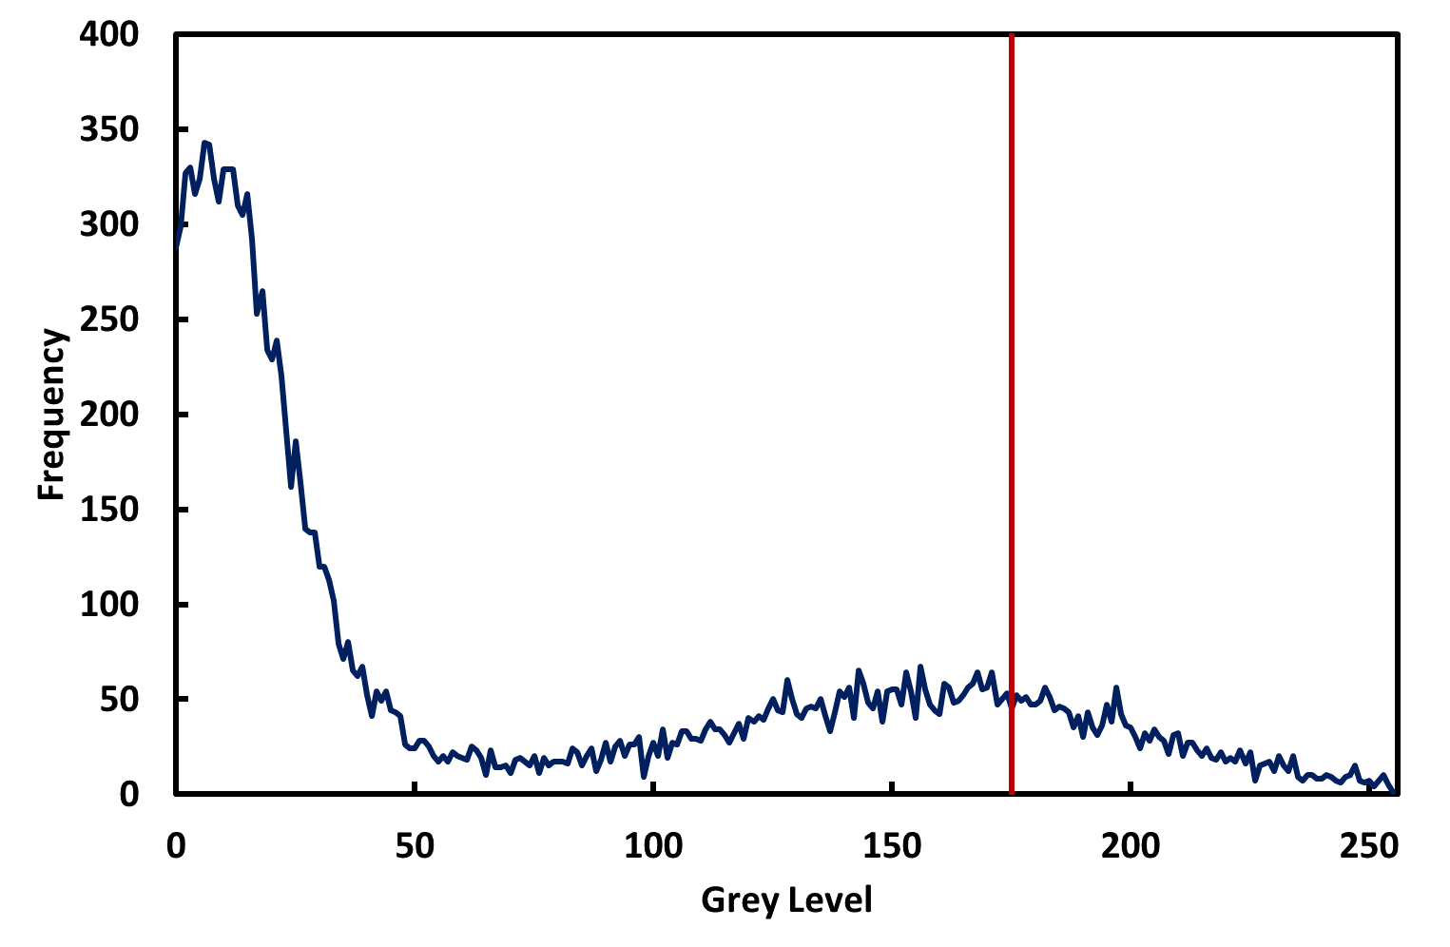
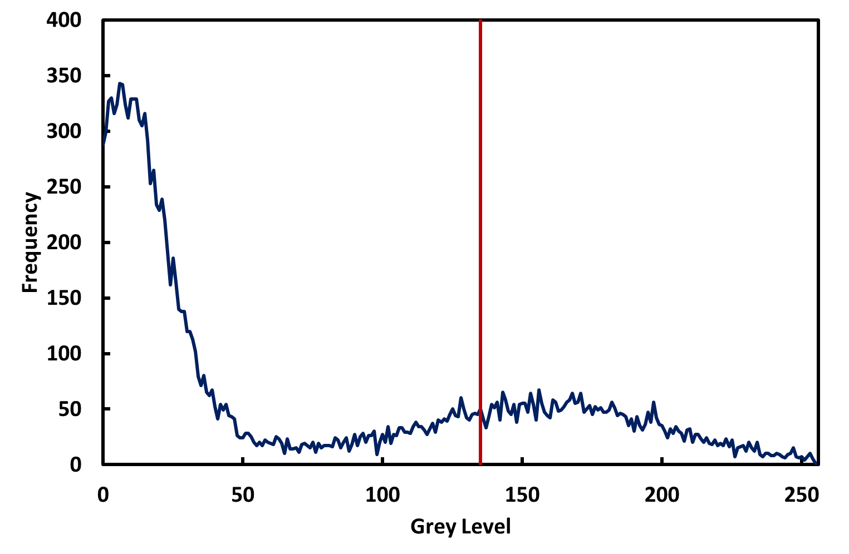
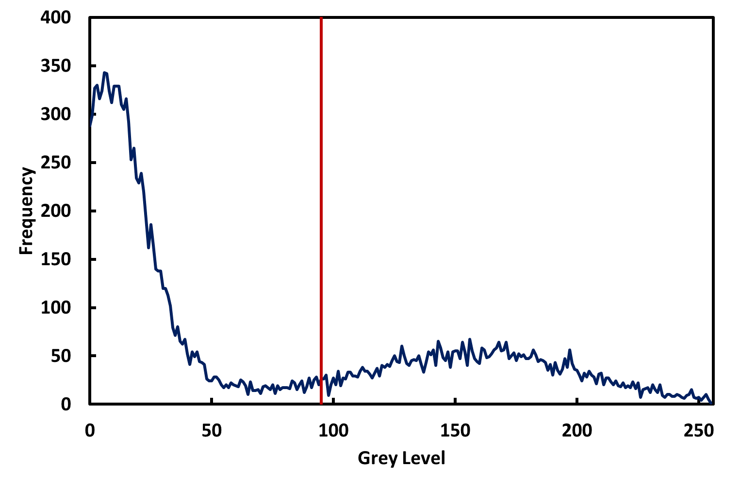
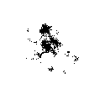


Background
Foreground
$$T> \frac{\text{Average} \text{of} \text{Foreground} \text{Pixels}+\text{Average} \text{of} \text{Background} \text{Pixels}}{2}$$
FIJI has several variations on this algorithm

Slide 13
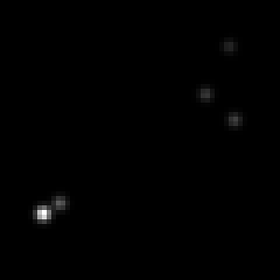
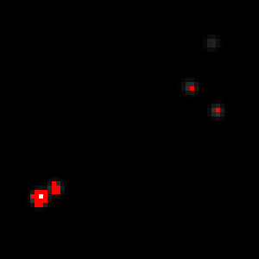
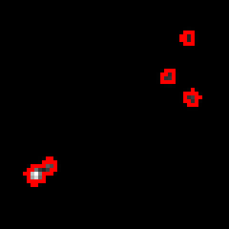
Can we segment particles this way?
If background is uniform and all exhibit similar intensity
Even then, not ideal:
Adjacent particles conjoined
Loss of localisation accuracy

Slide 14
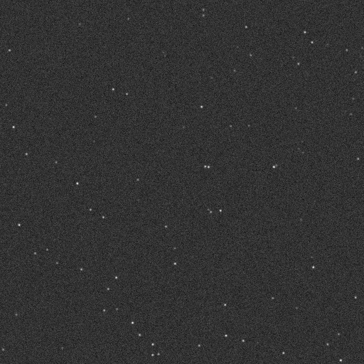
Demo 2 – detection by thresholding
Filter
Threshold
Analyze

Slide 15
Quiz 2 – detection by thresholding
Open the images in the Quiz 2 folder.
Using thresholding and the Particle Analyzer, how many particles can you detect in the two images?
Why do your answers almost certainly differ from the true value?

Slide 16
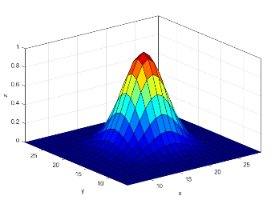
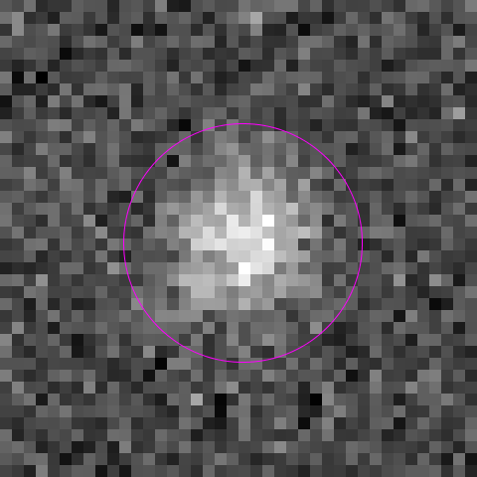
Other means of detection
0 | 0 | 0 | 1 | 0 | 0 | 0
0 | 1 | 6 | 10 | 6 | 1 | 0
0 | 6 | 29 | 50 | 31 | 7 | 1
1 | 11 | 52 | 90 | 55 | 12 | 1
0 | 7 | 33 | 57 | 35 | 8 | 1
0 | 2 | 7 | 13 | 8 | 2 | 0
0 | 0 | 1 | 1 | 1 | 0 | 0
Local maxima
Blobs
Gaussian (Point Spread Function)
Noise can complicate matters

Slide 17
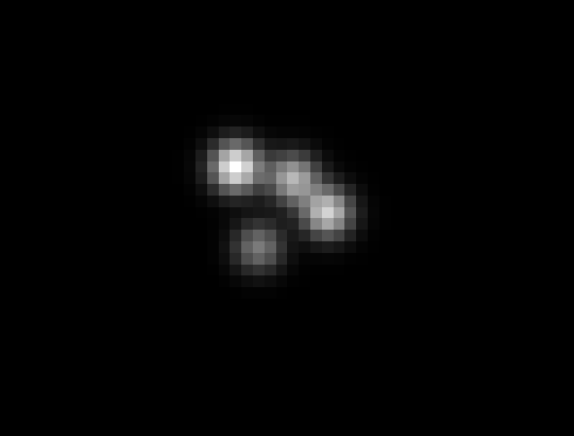
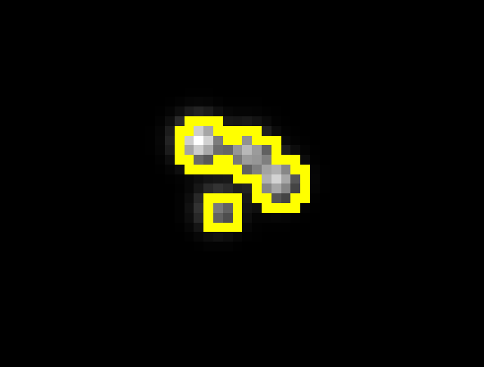
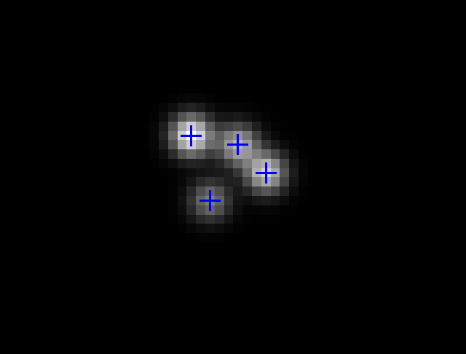
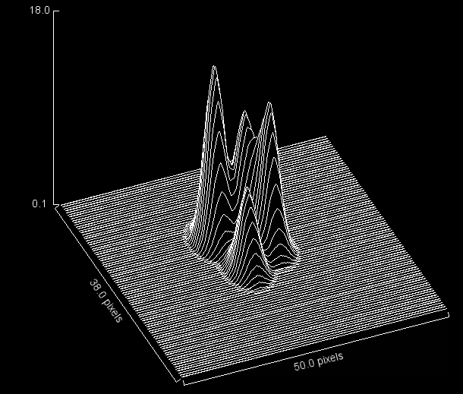
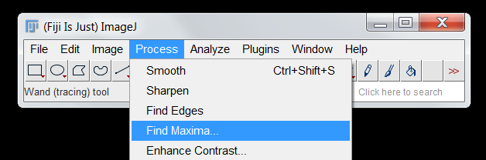

Slide 18

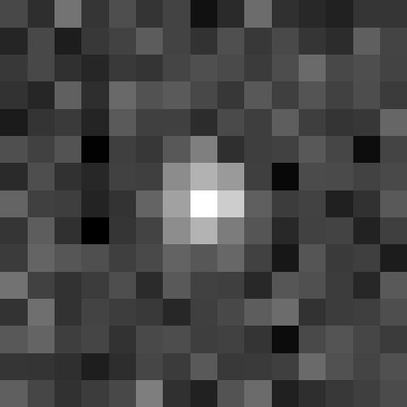
Detecting Local Maxima
33 | 21 | 54 | 25 | 36 | 24 | 31 | 8 | 19 | 50 | 22 | 18 | 15 | 25 | 25
17 | 34 | 13 | 26 | 31 | 43 | 31 | 23 | 37 | 26 | 34 | 25 | 20 | 44 | 32
26 | 33 | 23 | 17 | 27 | 24 | 32 | 37 | 34 | 28 | 36 | 49 | 34 | 36 | 31
23 | 18 | 44 | 22 | 49 | 38 | 42 | 34 | 25 | 41 | 29 | 39 | 30 | 36 | 28
12 | 24 | 27 | 17 | 42 | 30 | 30 | 20 | 34 | 29 | 44 | 29 | 24 | 26 | 47
37 | 30 | 38 | 1 | 29 | 26 | 41 | 84 | 22 | 29 | 30 | 41 | 33 | 6 | 31
20 | 36 | 23 | 18 | 30 | 29 | 65 | 83 | 72 | 29 | 4 | 35 | 34 | 30 | 34
47 | 30 | 29 | 16 | 23 | 46 | 75 | 84 | 81 | 44 | 28 | 31 | 15 | 23 | 41
24 | 43 | 22 | 0 | 25 | 31 | 65 | 83 | 58 | 39 | 18 | 30 | 31 | 16 | 29
27 | 47 | 40 | 37 | 29 | 34 | 46 | 40 | 48 | 30 | 11 | 40 | 27 | 29 | 13
53 | 30 | 23 | 28 | 36 | 20 | 41 | 30 | 29 | 18 | 40 | 37 | 28 | 18 | 42
24 | 51 | 23 | 31 | 28 | 26 | 18 | 29 | 34 | 43 | 50 | 23 | 28 | 29 | 36
41 | 46 | 29 | 32 | 23 | 34 | 36 | 29 | 30 | 24 | 6 | 34 | 39 | 32 | 27
25 | 24 | 22 | 14 | 21 | 33 | 27 | 41 | 26 | 27 | 29 | 49 | 38 | 32 | 37
44 | 33 | 23 | 28 | 34 | 58 | 22 | 15 | 38 | 50 | 15 | 22 | 26 | 29 | 35
0 | 0 | 0 | 1 | 0 | 0 | 0
0 | 1 | 6 | 10 | 6 | 1 | 0
0 | 6 | 29 | 50 | 31 | 7 | 1
1 | 11 | 52 | 90 | 55 | 12 | 1
0 | 7 | 33 | 57 | 35 | 8 | 1
0 | 2 | 7 | 13 | 8 | 2 | 0
0 | 0 | 1 | 1 | 1 | 0 | 0

Slide 19
Filtering Suppresses noise
33 | 21 | 54 | 25 | 36 | 24 | 31 | 8 | 19 | 50 | 22 | 18 | 15 | 25 | 25
17 | 34 | 13 | 26 | 31 | 43 | 31 | 23 | 37 | 26 | 34 | 25 | 20 | 44 | 32
26 | 33 | 23 | 17 | 27 | 24 | 32 | 37 | 34 | 28 | 36 | 49 | 34 | 36 | 31
23 | 18 | 44 | 22 | 49 | 38 | 42 | 34 | 25 | 41 | 29 | 39 | 30 | 36 | 28
12 | 24 | 27 | 17 | 42 | 30 | 30 | 20 | 34 | 29 | 44 | 29 | 24 | 26 | 47
37 | 30 | 38 | 1 | 29 | 26 | 41 | 84 | 22 | 29 | 30 | 41 | 33 | 6 | 31
20 | 36 | 23 | 18 | 30 | 29 | 65 | 83 | 72 | 29 | 4 | 35 | 34 | 30 | 34
47 | 30 | 29 | 16 | 23 | 46 | 75 | 84 | 81 | 44 | 28 | 31 | 15 | 23 | 41
24 | 43 | 22 | 0 | 25 | 31 | 65 | 83 | 58 | 39 | 18 | 30 | 31 | 16 | 29
27 | 47 | 40 | 37 | 29 | 34 | 46 | 40 | 48 | 30 | 11 | 40 | 27 | 29 | 13
53 | 30 | 23 | 28 | 36 | 20 | 41 | 30 | 29 | 18 | 40 | 37 | 28 | 18 | 42
24 | 51 | 23 | 31 | 28 | 26 | 18 | 29 | 34 | 43 | 50 | 23 | 28 | 29 | 36
41 | 46 | 29 | 32 | 23 | 34 | 36 | 29 | 30 | 24 | 6 | 34 | 39 | 32 | 27
25 | 24 | 22 | 14 | 21 | 33 | 27 | 41 | 26 | 27 | 29 | 49 | 38 | 32 | 37
44 | 33 | 23 | 28 | 34 | 58 | 22 | 15 | 38 | 50 | 15 | 22 | 26 | 29 | 35
6 | 8 | 10 | 9 | 8 | 7 | 4 | 1 | 4 | 9 | 6 | 1 | 0 | 3 | 4
3 | 5 | 5 | 5 | 7 | 9 | 7 | 5 | 7 | 9 | 8 | 6 | 6 | 8 | 8
2 | 4 | 4 | 4 | 8 | 10 | 10 | 9 | 9 | 10 | 11 | 11 | 10 | 10 | 10
1 | 3 | 5 | 6 | 10 | 12 | 11 | 10 | 9 | 10 | 12 | 12 | 10 | 10 | 10
1 | 3 | 4 | 4 | 8 | 11 | 13 | 13 | 11 | 10 | 11 | 10 | 8 | 7 | 11
5 | 6 | 3 | 1 | 5 | 12 | 21 | 25 | 19 | 11 | 8 | 9 | 6 | 5 | 9
8 | 7 | 3 | 0 | 5 | 17 | 34 | 43 | 35 | 17 | 7 | 6 | 6 | 6 | 9
11 | 9 | 4 | 0 | 6 | 21 | 41 | 53 | 43 | 22 | 8 | 5 | 4 | 5 | 9
11 | 11 | 6 | 1 | 6 | 18 | 34 | 43 | 35 | 18 | 7 | 5 | 4 | 3 | 5
13 | 13 | 9 | 6 | 7 | 13 | 22 | 25 | 21 | 12 | 7 | 7 | 6 | 4 | 4
15 | 14 | 9 | 7 | 7 | 9 | 12 | 13 | 12 | 10 | 9 | 9 | 7 | 6 | 7
14 | 13 | 9 | 7 | 6 | 6 | 7 | 8 | 9 | 9 | 10 | 9 | 8 | 8 | 10
13 | 12 | 7 | 5 | 5 | 7 | 8 | 8 | 8 | 7 | 7 | 9 | 10 | 10 | 10
11 | 8 | 4 | 3 | 6 | 9 | 9 | 8 | 8 | 7 | 6 | 9 | 10 | 10 | 11
14 | 9 | 4 | 5 | 10 | 14 | 9 | 6 | 10 | 11 | 6 | 5 | 7 | 9 | 11

Slide 20
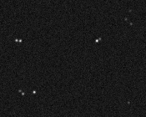
Demo 3 – Local Maxima Detection
Demonstrate benefits of local maxima detection versus thresholding

Slide 21
Quiz 3 – Local Maxima Detection
Open the images in the Quiz 3 folder.
Using the maxima finder, determine how many particles there are in Dots_1.ome.tif
Using a combination of filtering and the maxima finder, count the number of particles in Dots_2.ome.tif

Slide 22
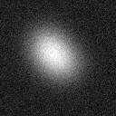
Gaussian Filtering is the basis for blob detection
For “blob-like” objects, a Laplacian-of-Gaussian (LoG) works quite well
A Difference-of-Gaussians (DoG) is similar, but often works better for smaller objects

Slide 23
Laplacian of gaussian

Slide 24
Effect of LoG Filtering
33 | 21 | 54 | 25 | 36 | 24 | 31 | 8 | 19 | 50 | 22 | 18 | 15 | 25 | 25
17 | 34 | 13 | 26 | 31 | 43 | 31 | 23 | 37 | 26 | 34 | 25 | 20 | 44 | 32
26 | 33 | 23 | 17 | 27 | 24 | 32 | 37 | 34 | 28 | 36 | 49 | 34 | 36 | 31
23 | 18 | 44 | 22 | 49 | 38 | 42 | 34 | 25 | 41 | 29 | 39 | 30 | 36 | 28
12 | 24 | 27 | 17 | 42 | 30 | 30 | 20 | 34 | 29 | 44 | 29 | 24 | 26 | 47
37 | 30 | 38 | 1 | 29 | 26 | 41 | 84 | 22 | 29 | 30 | 41 | 33 | 6 | 31
20 | 36 | 23 | 18 | 30 | 29 | 65 | 83 | 72 | 29 | 4 | 35 | 34 | 30 | 34
47 | 30 | 29 | 16 | 23 | 46 | 75 | 84 | 81 | 44 | 28 | 31 | 15 | 23 | 41
24 | 43 | 22 | 0 | 25 | 31 | 65 | 83 | 58 | 39 | 18 | 30 | 31 | 16 | 29
27 | 47 | 40 | 37 | 29 | 34 | 46 | 40 | 48 | 30 | 11 | 40 | 27 | 29 | 13
53 | 30 | 23 | 28 | 36 | 20 | 41 | 30 | 29 | 18 | 40 | 37 | 28 | 18 | 42
24 | 51 | 23 | 31 | 28 | 26 | 18 | 29 | 34 | 43 | 50 | 23 | 28 | 29 | 36
41 | 46 | 29 | 32 | 23 | 34 | 36 | 29 | 30 | 24 | 6 | 34 | 39 | 32 | 27
25 | 24 | 22 | 14 | 21 | 33 | 27 | 41 | 26 | 27 | 29 | 49 | 38 | 32 | 37
44 | 33 | 23 | 28 | 34 | 58 | 22 | 15 | 38 | 50 | 15 | 22 | 26 | 29 | 35
34 | 35 | 38 | 39 | 38 | 37 | 33 | 33 | 34 | 33 | 34 | 37 | 33 | 28 | 25
35 | 37 | 38 | 37 | 37 | 37 | 36 | 36 | 37 | 35 | 36 | 37 | 34 | 30 | 25
38 | 37 | 36 | 36 | 35 | 33 | 31 | 31 | 33 | 33 | 34 | 37 | 37 | 34 | 30
35 | 34 | 35 | 35 | 32 | 27 | 21 | 19 | 20 | 23 | 28 | 33 | 37 | 38 | 35
33 | 34 | 35 | 34 | 27 | 17 | 10 | 7 | 8 | 11 | 19 | 28 | 33 | 35 | 35
36 | 37 | 37 | 32 | 20 | 7 | 2 | 3 | 2 | 3 | 11 | 23 | 31 | 34 | 34
37 | 38 | 37 | 28 | 13 | 2 | 3 | 13 | 8 | 0 | 6 | 19 | 30 | 35 | 36
35 | 35 | 34 | 24 | 10 | 2 | 10 | 29 | 16 | 1 | 5 | 18 | 30 | 36 | 38
37 | 36 | 32 | 22 | 11 | 4 | 10 | 17 | 8 | 0 | 6 | 20 | 31 | 37 | 39
37 | 38 | 32 | 23 | 14 | 7 | 5 | 4 | 2 | 3 | 12 | 24 | 33 | 38 | 39
35 | 37 | 35 | 27 | 19 | 12 | 8 | 6 | 7 | 12 | 20 | 30 | 36 | 38 | 37
34 | 35 | 36 | 31 | 25 | 20 | 18 | 17 | 19 | 23 | 29 | 35 | 38 | 38 | 37
34 | 34 | 36 | 35 | 31 | 29 | 27 | 27 | 28 | 30 | 34 | 37 | 38 | 37 | 36
34 | 35 | 36 | 36 | 35 | 34 | 34 | 33 | 32 | 33 | 35 | 36 | 37 | 35 | 33
36 | 35 | 36 | 37 | 36 | 36 | 37 | 36 | 34 | 34 | 35 | 36 | 37 | 33 | 30

Slide 25
Effect of DOG Filtering
33 | 21 | 54 | 25 | 36 | 24 | 31 | 8 | 19 | 50 | 22 | 18 | 15 | 25 | 25
17 | 34 | 13 | 26 | 31 | 43 | 31 | 23 | 37 | 26 | 34 | 25 | 20 | 44 | 32
26 | 33 | 23 | 17 | 27 | 24 | 32 | 37 | 34 | 28 | 36 | 49 | 34 | 36 | 31
23 | 18 | 44 | 22 | 49 | 38 | 42 | 34 | 25 | 41 | 29 | 39 | 30 | 36 | 28
12 | 24 | 27 | 17 | 42 | 30 | 30 | 20 | 34 | 29 | 44 | 29 | 24 | 26 | 47
37 | 30 | 38 | 1 | 29 | 26 | 41 | 84 | 22 | 29 | 30 | 41 | 33 | 6 | 31
20 | 36 | 23 | 18 | 30 | 29 | 65 | 83 | 72 | 29 | 4 | 35 | 34 | 30 | 34
47 | 30 | 29 | 16 | 23 | 46 | 75 | 84 | 81 | 44 | 28 | 31 | 15 | 23 | 41
24 | 43 | 22 | 0 | 25 | 31 | 65 | 83 | 58 | 39 | 18 | 30 | 31 | 16 | 29
27 | 47 | 40 | 37 | 29 | 34 | 46 | 40 | 48 | 30 | 11 | 40 | 27 | 29 | 13
53 | 30 | 23 | 28 | 36 | 20 | 41 | 30 | 29 | 18 | 40 | 37 | 28 | 18 | 42
24 | 51 | 23 | 31 | 28 | 26 | 18 | 29 | 34 | 43 | 50 | 23 | 28 | 29 | 36
41 | 46 | 29 | 32 | 23 | 34 | 36 | 29 | 30 | 24 | 6 | 34 | 39 | 32 | 27
25 | 24 | 22 | 14 | 21 | 33 | 27 | 41 | 26 | 27 | 29 | 49 | 38 | 32 | 37
44 | 33 | 23 | 28 | 34 | 58 | 22 | 15 | 38 | 50 | 15 | 22 | 26 | 29 | 35
1 | 1 | 1 | 1 | 1 | 2 | 1 | 1 | 2 | 1 | 2 | 2 | 1 | 0 | 1
1 | 2 | 2 | 1 | 1 | 2 | 2 | 2 | 1 | 1 | 2 | 1 | 1 | 1 | 1
3 | 2 | 1 | 0 | 0 | 2 | 3 | 4 | 3 | 2 | 2 | 2 | 2 | 1 | 2
2 | 1 | 0 | 0 | 2 | 3 | 3 | 2 | 2 | 3 | 4 | 3 | 2 | 1 | 2
1 | 1 | 0 | 1 | 4 | 4 | 1 | 2 | 1 | 2 | 5 | 3 | 1 | 0 | 1
2 | 1 | 1 | 3 | 5 | 2 | 4 | 9 | 7 | 2 | 2 | 3 | 1 | 0 | 0
2 | 1 | 1 | 4 | 3 | 3 | 11 | 17 | 15 | 7 | 1 | 3 | 2 | 0 | 0
1 | 1 | 2 | 4 | 2 | 5 | 15 | 21 | 19 | 9 | 2 | 3 | 2 | 1 | 0
2 | 2 | 3 | 3 | 1 | 5 | 13 | 18 | 15 | 6 | 1 | 3 | 2 | 1 | 1
1 | 2 | 3 | 2 | 1 | 4 | 7 | 9 | 6 | 2 | 2 | 3 | 2 | 1 | 0
1 | 2 | 3 | 2 | 1 | 1 | 1 | 1 | 1 | 2 | 5 | 4 | 2 | 0 | 0
1 | 1 | 2 | 3 | 2 | 2 | 2 | 2 | 2 | 3 | 3 | 2 | 1 | 0 | 0
0 | 1 | 1 | 2 | 2 | 2 | 2 | 2 | 1 | 1 | 1 | 0 | 1 | 1 | 1
0 | 1 | 1 | 1 | 1 | 1 | 1 | 1 | 0 | 0 | 0 | 0 | 1 | 1 | 2
0 | 0 | 1 | 2 | 1 | 0 | 0 | 0 | 0 | 1 | 1 | 0 | 1 | 2 | 1

Slide 26
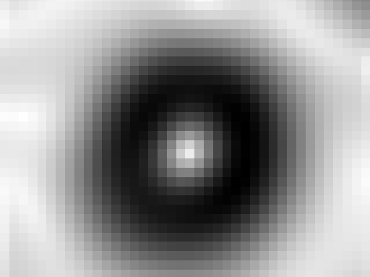
Demo 4 – BLOB Detection
Demonstrate principles of blob detection:
LoG Filtering
DoG Filtering

Slide 27
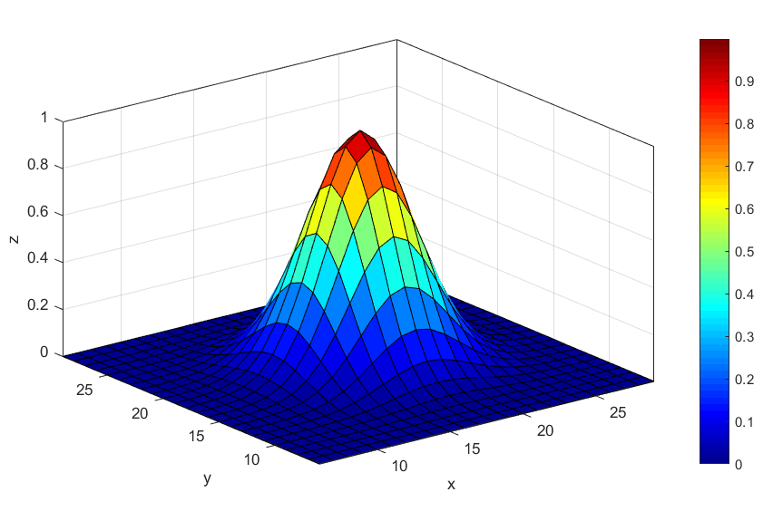
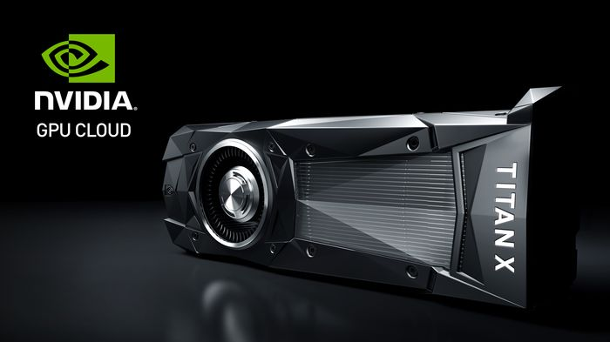
Gaussian Fitting
Fitting to “Point Spread Function”:
Most rigorous approach.
Accurate sub-pixel localisation
Computationally intensive
Only suitable for objects below diffraction limit (< approx. 250 nm)

Slide 28
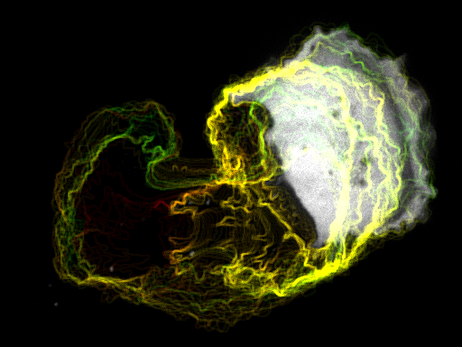
Tracking Cells
A few things to bear in mind

Slide 29
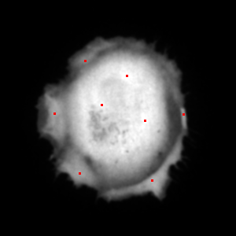
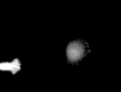

In theory, cells can be tracked in a similar manner
However….
Cells have more than one single maximum
Representing cells as single points loses morphological information
Cells often come into contact with one another

Slide 30
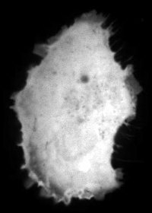

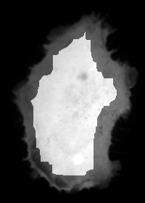
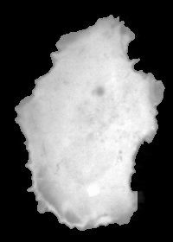
Region-growing Algorithm
Growth terminates when p_{x,y} < T_{g}
Shrink
Regrow
Frame t
Frame t + 1

Slide 31
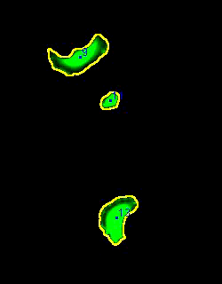
Implicitly tracks cells from frame to frame
Can deal with a certain amount of cell-cell contact
Morphology of cells can be measured at each frame
Frame rate needs to be high
High cell density will cause problems

Slide 32
Demo 6 - Tracking Cells

Slide 33
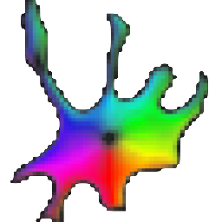
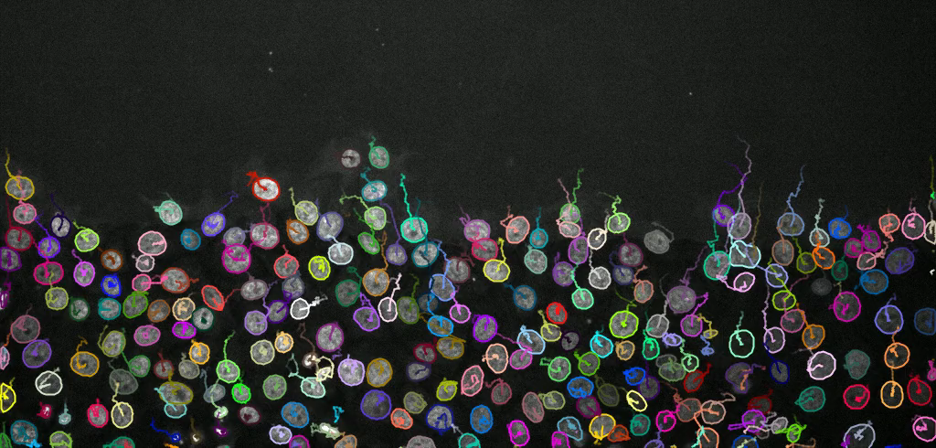

Other methods

